Slide 1
Human Action Classification in the Epic Kitchen Scenario using Deep Learning and RGB data
Edoardo Balducci, Enrico Corradini, Alessandro Mentuccia

Slide 2
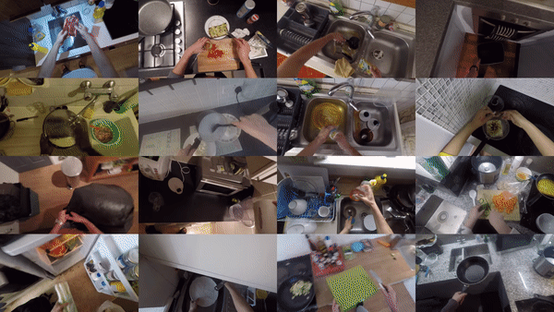
Problem introduction
Epic Kitchens Dataset: daily kitchen actions videos
32 different kitchens along with first-person shooted videos
Need of a classifier able to recognize actions from videos

Slide 3
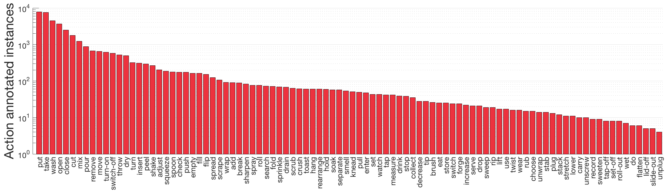
State of art (1)
Classes and related images already annotated by Epic Kitchens’ creators
Epic Kitchens dataset contains a total of 125 verb classes
“Scaling Egocentric Vision: The EPIC-KITCHENS Dataset” paper about their experiment

Slide 4
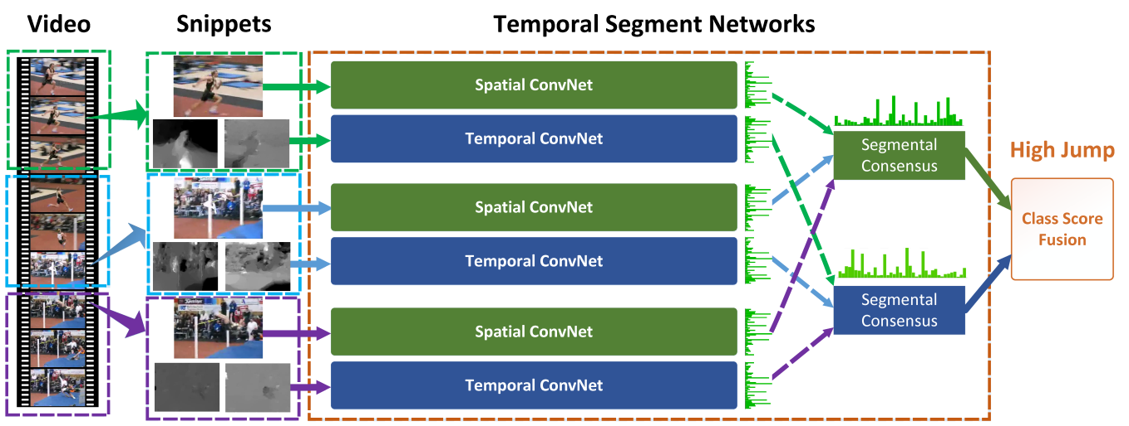
State of art (2)
Temporal Segment Networks is a modified version of Caffe, adding the VideoData layer, developed for actions recognition
Temporal Segment Networks uses RGB and FLOW frames, enabling parallel processing with Open MPI library
Dense Flow for X and Y flows extraction, based on OpenCV’s cuda::DenseOpticalFlow algorithm
The authors provide a pre-trained model for actions recognition

Slide 5
Goal
Human actions recognition
Original dataset analysis, frames classification and flow extraction
Deep learning model for a supervised human actions classifier

Slide 6
Technology
Temporal Segment Networks fork
Python scripts for pre-processing
Dataset creation and analysis
Caffe: deep learning framework
Optical flow extraction
Learning splits generation
Modified version adding VideoData layer

Slide 7
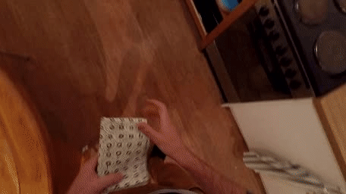
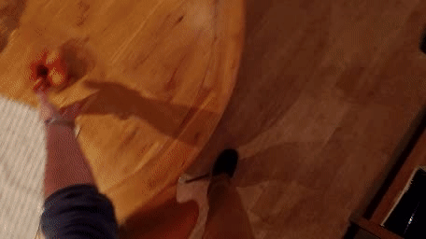
Challenges (1)
Huge dataset: 32 different kitchens, 1 TB
Working only on one kitchen: 60 GB
No free cloud storage for Google Colab: working locally, limited hardware and time
Many classes are difficult to distinguish from others
PUT
TAKE

Slide 8
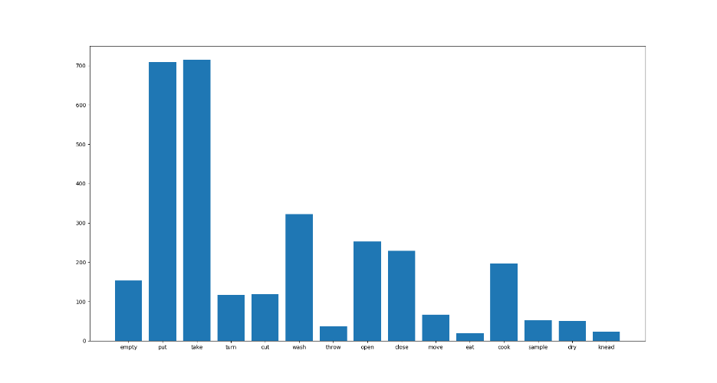
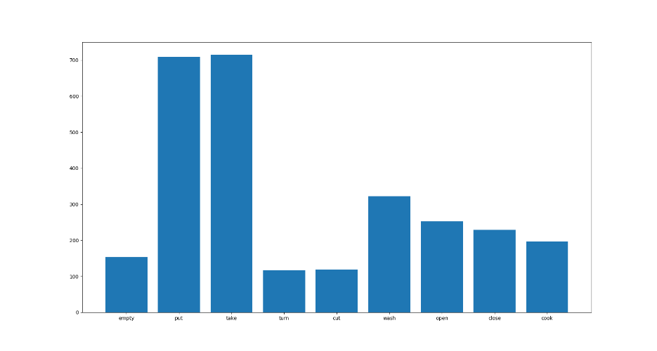
Challenges (2)
Few examples for many classes using only one kitchen as dataset
Highly unbalanced dataset
Some classes grouped together

Slide 9
Method: dataset creation
Downloaded first kitchen’s source videos from Epic Kitchens database
Removed all classes with less than 100 examples
Grouped frames by action
Python script «create_dataset.py»
«id_action» folders created for each example in dataset
Each folder contains RGB frames (.jpg)
Python script «analyze_dataset.py»
Created final dataset used for training, with optical flow extraction
«create_video.py» and «optical_flow.py» python scripts
.avi video created from frames, requested by Dense Flow’s «extract_gpu» binary
Frames folders now contain RGB, X flow and Y flow frames

Slide 10
Method: network training and testing
Splitting dataset
Testing
Training
$ ./caffe train –solver=models/epic_kitchens_rgb_solver.prototxt –weights=models/start_model.caffemodel
Temporal Segment Networks caffemodel used for actions recognition as starting weights
Problem reduced to 3 classes, then added one classe each time until 5 classes were reached
Python script «eval_net.py»
Calculating final results
Precision
Python script «prepare_training.py»
Dataset splitted by 70% for training and 30% for testing
Training dataset splitted by 70% for training and 30% for validation
Confusion matrix extraction
Recall
F-score

Slide 11
Results

Slide 12
Obiettivi per la verifica successiva
Data del prossimo aggiornamento dello stato
Elencare gli obiettivi per la verifica successiva
Elementi specifici che saranno completati
Problemi che verranno risolti
Assicurarsi che chiunque sia coinvolto nel progetto comprenda il piano di azione

